Slide 1









INSOMINA EARSER
GRAUDATION PROJECT

Slide 2



SUPERVISED BY :
Prof: Amira Idrees
ENG/ NORHAN KHASHABA
TEAM
1 - ANAS MAHMOUD MOHAMED (20-00668)
2 - MOSTAFA MOHAMED SHAWKY GAD (20-01693)
3 - ABDALLAH SALAH ABDELKAREEM (20-00539)
4 - ADHAM ALLA ABDELAZZEEM (20-01203)
5 - MARCO MILAD MANKARUIOS (20-00023)
6 - MARWAN HESHAM ABDELMONEM (20-01319)

Slide 3
OUTLINE
Introduction
Problem Statement
Objectives (Solutions)
Requirement Analysis
Diagrams
Mobile Application
Proposed model
Dataset
Conlusion
Reference
Future Work

Slide 4



INTRODUCTION
Sleep is essential for health, allowing the body and mind to rest and repair. Many people suffer from insomnia, which makes it hard to fall asleep or stay asleep. This can lead to fatigue, irritability, and impaired cognitive function, increasing the risk of chronic health issues.
Insomnia has many causes, including stress, anxiety, medical conditions, and environmental factors. Treating insomnia often requires lifestyle changes, cognitive-behavioral therapy, and sometimes medication. With the right diagnosis and treatment, individuals can improve their sleep and overall health.

Slide 5



REQUIREMENT ANALYSIS
1. Interviews: Conduct one-on-one or group interviews with potential users,
sleep experts, psychologists, healthcare professionals, and other stakeholders.
Ask open-ended questions to gather insights into their sleep patterns,
challenges, preferences, and expectations from the application.
2. Surveys and Questionnaires: Design and distribute surveys or
questionnaires to a wide audience to collect quantitative and qualitative data
on sleep habits, preferences, and
desired features. Analyse the responses to
identify common patterns and requirements.
3. Focus Groups: Organize interactive group discussions with a diverse set
of stakeholders to encourage brainstorming, idea sharing, and gathering
different perspectives on the desired features and functionalities of the
insomnia application.

Slide 6
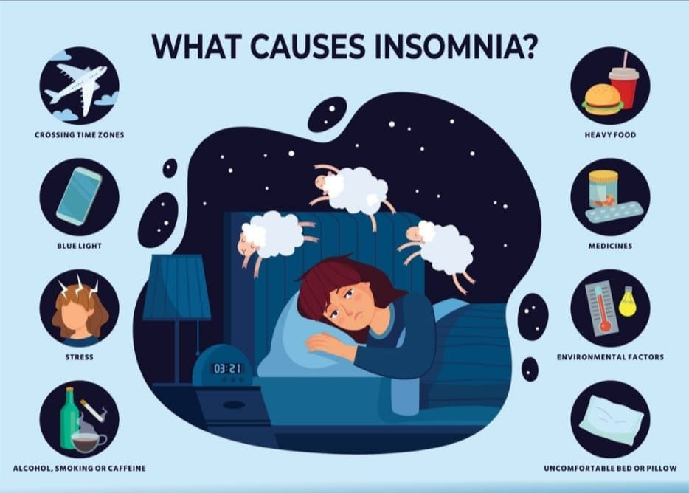

Slide 7


PROBLEM STATEMENT
In this project, we address the widespread problem of insomnia, a sleep disorder making it hard to fall asleep, stay asleep, or causing early waking. Insomnia affects energy, mood, health, work performance, and quality of life. We aim to help people of all ages suffering from insomnia, caused by factors like psychological conditions, stress, poor sleep habits, and travel.
Our solution includes providing patients with vital information about insomnia, helping them recognize and treat it, and offering 24/7 doctor communication for chronic cases. For issues like excessive thinking, anxiety, or stimulant use, we offer a personalized library with resources including exercise and diet plans, Quran recitations, calming music, and medical advice to improve sleep and overall well-being.

Slide 8
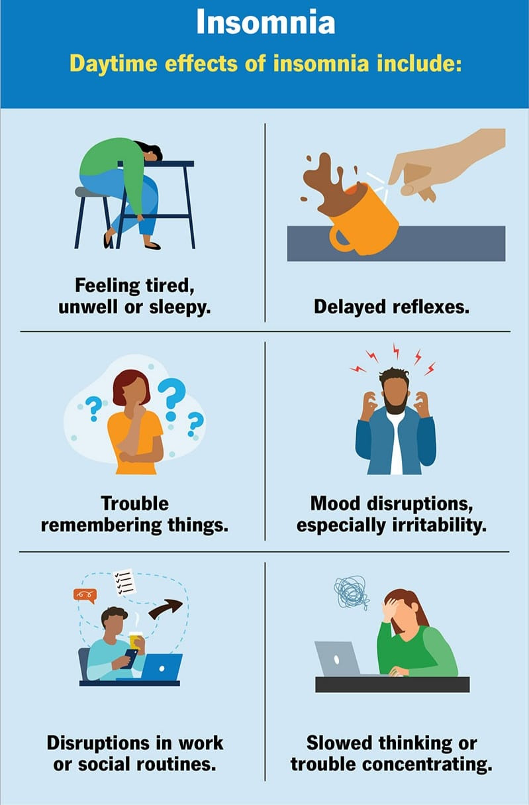

Slide 9
SOLUTION
Treating sleep disorders is crucial to society as it contributes to enhancing individuals’ overall health and psychological well-being Improving sleep quality can increase productivity at work, mitigate negative effects on daily performance, and address anxiety prevalent in society. Furthermore, focusing on treating sleep problems helps reduce the overall burden on
public health and health care costs, ultimately benefiting society as a whole,

Slide 10

OBJECTIVES OF PROJECT
1
2
3
Facilitate booking and managing appointments, as the patient can book at any time convenient for him, which saves him time. through text or voice messages or chat through the application, which helps
Help patients identify and overcome insomnia through many mean
Make it easier for patients to find doctors.

Slide 11
4
5
Improve communication that patients and doctors can Communicate better in exchanging information faster and easier.
Providing various medical programs that help
change the patient’s lifestyle.

Slide 12
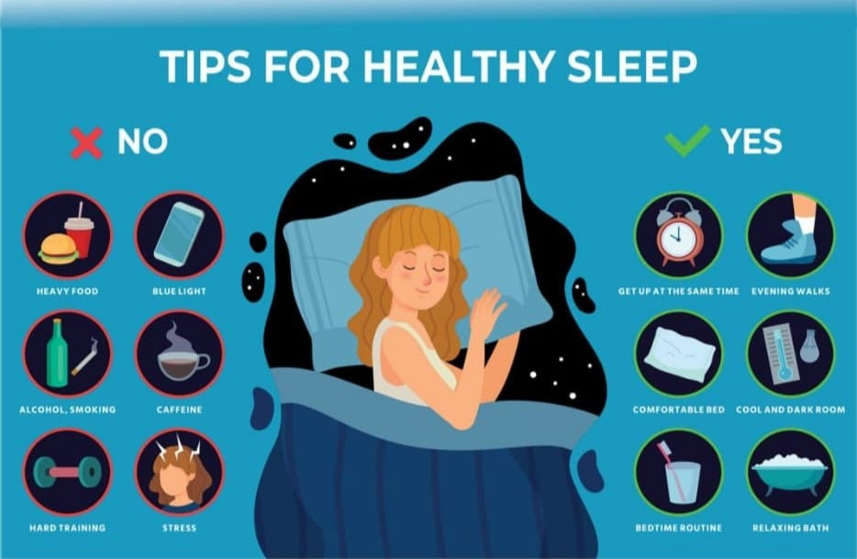

Slide 13
Patient functional requirement :-
The system allows patient login by using basic information about him, like as name, age, email, governorate and Marital status.
. The system allows all users to use a library that contains a variety of music that helps them relax.
.The system allows all users to use a library containing a collection of different books that help provide psychological comfort.
.The system allows all users to help them improve and organize their diet by distributing it in a healthy manner throughout the day in addition to suggesting different healthy meals.
.The system allows all users to help them enter conversations with various doctors and take instructions through chat

Slide 14
Doctor functional requirement:
.The system allows doctors login by using basic information about him, like as name, age, email
.The system allows the doctor to receive inquiries from patients individually
.The system allows the doctor to receive inquiries received from patients individually and respond to them in the form of chat conversations.

Slide 15
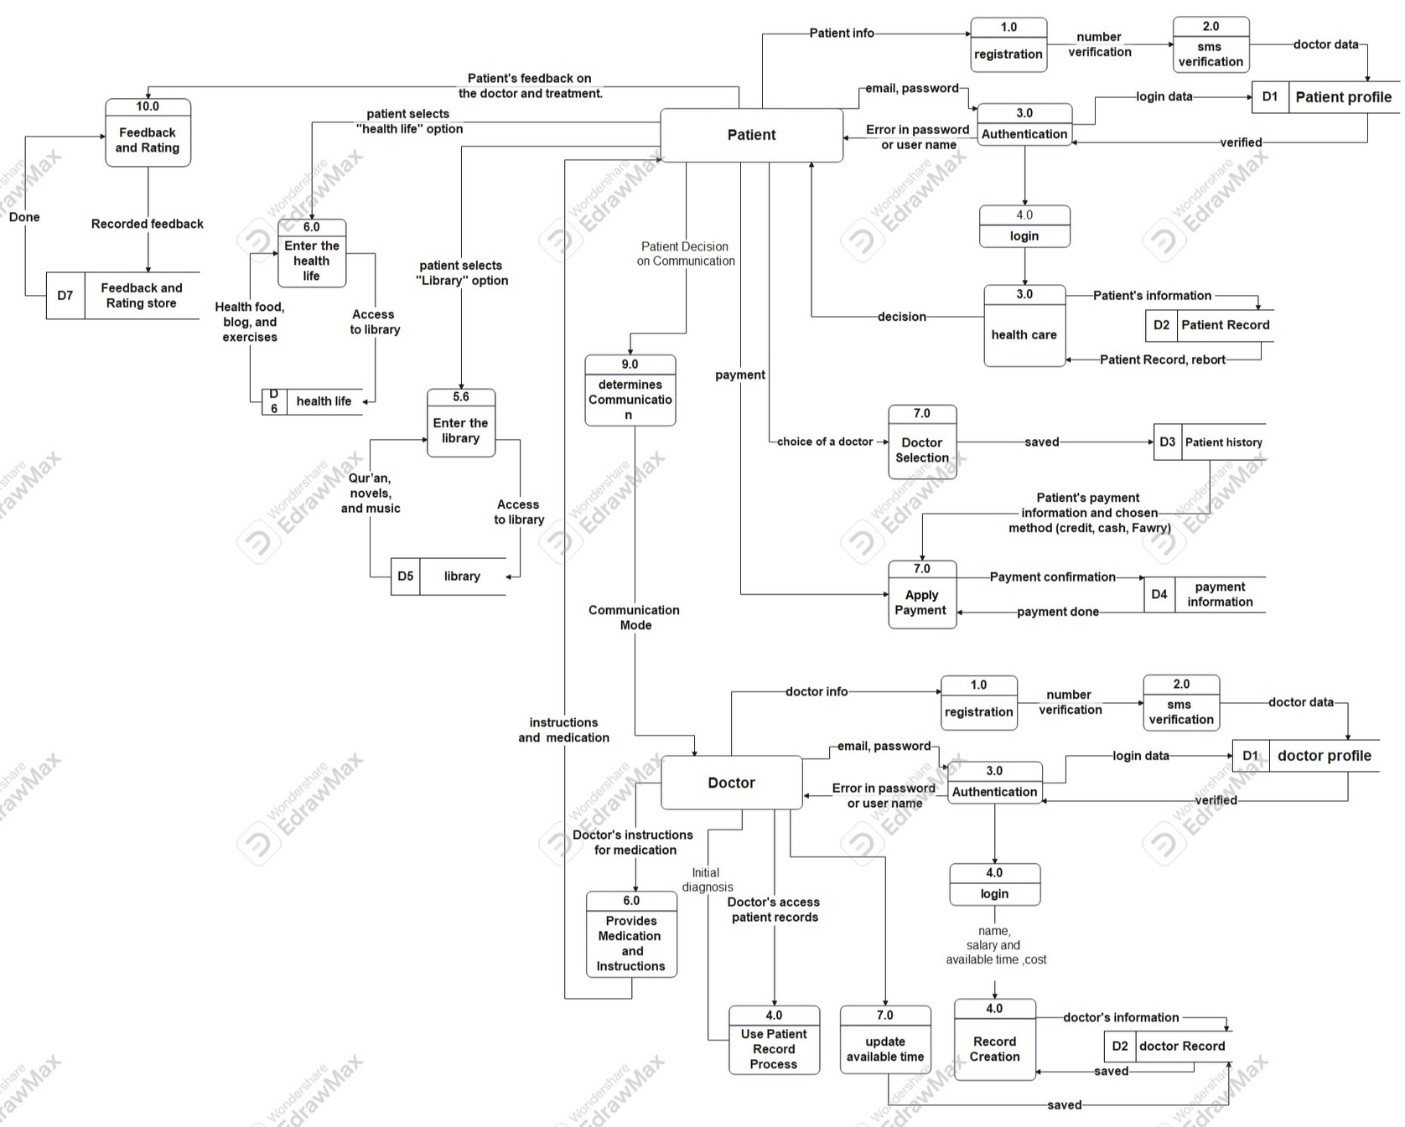
4.3 Data flow diagram

Slide 16
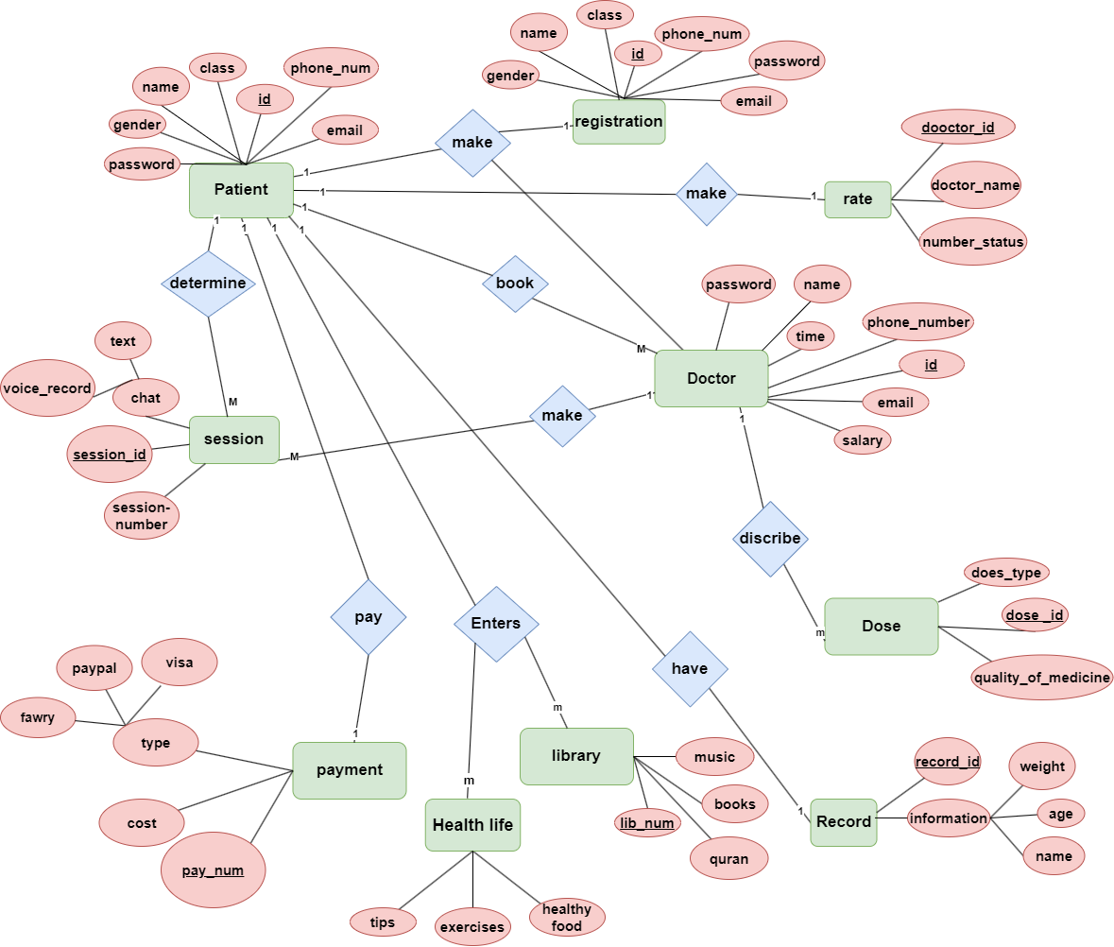
4.4 Entity relationship diagram

Slide 17
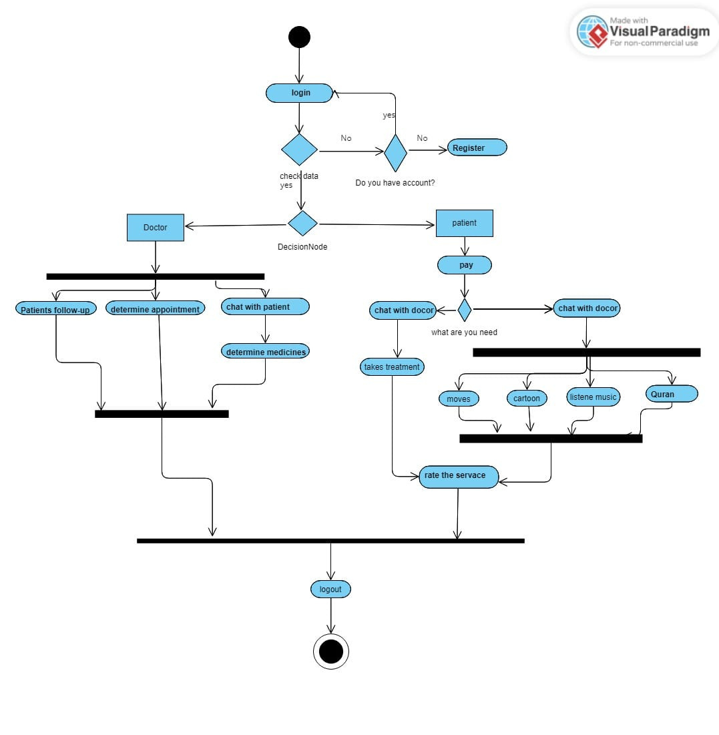
4.6 UML Activity diagram

Slide 18
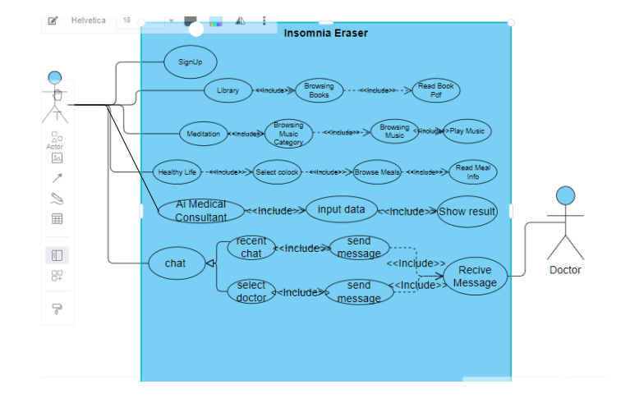
4.5 UML use case diagram

Slide 19
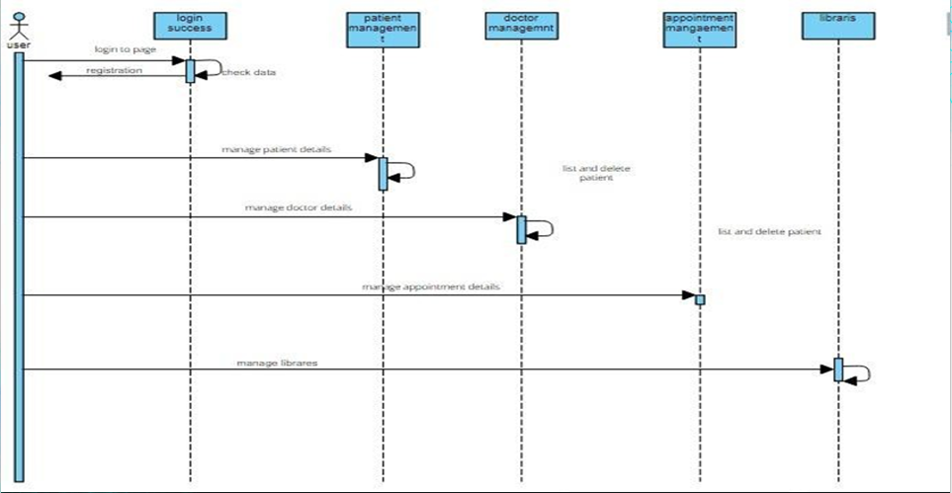
4.7 UML Sequence diagram

Slide 20
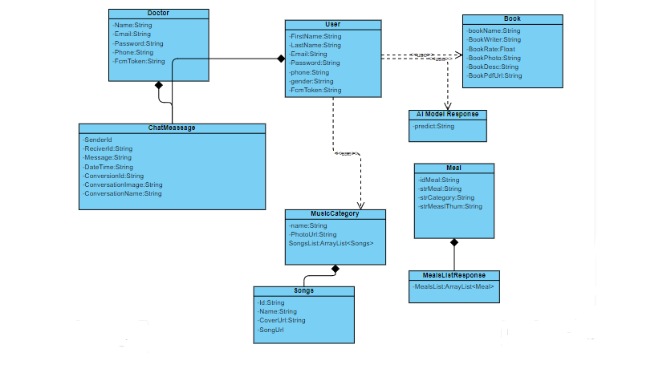

Slide 21




TOOLS

Slide 22
Platforms:
Android Studio, Adobe XD.
Server side:
Firebase. Databases: Firestore, Extenal Storage, Shared Preferences.
Programming Languages:
Kotlin, XML. Other Tools: MVVM, Coroutines, Firebase Store, Firebase Messaging, Notification, Retrofit, State Flow, PDF Viewer, View Binding, intuit

Slide 23
APPLICATION

Slide 24
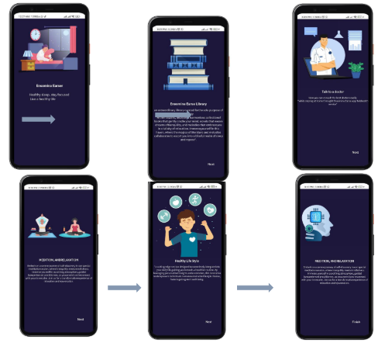
SPLASH SCREEN & STORYBOARD

Slide 25
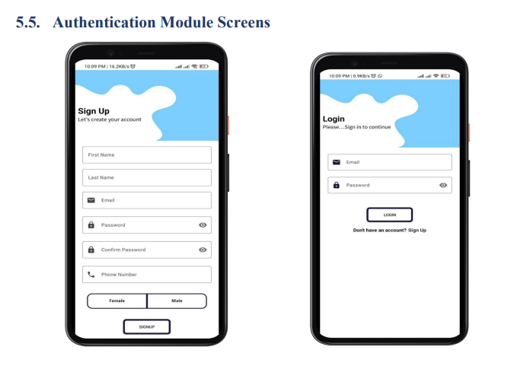

Slide 26
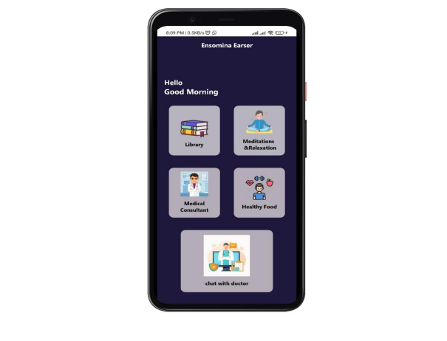
HOME SCREEN
The Home Page of our Android application serves as the central hub for all the features designed to help users combat insomnia and improve their overall well-being. The Home Page is intuitively organized into five main sections
1.Library of Books
2.Library of Songs for Relaxation
3.Healthy Foods
4.Ai Medical Consultant
5.Chat with a Doctor

Slide 27

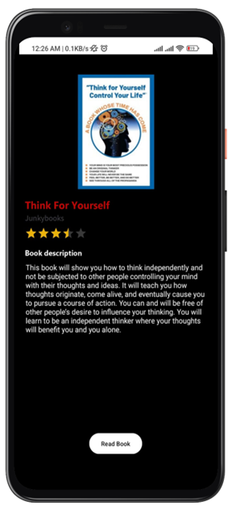

Books Library Screen

Slide 28
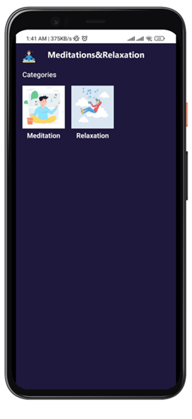
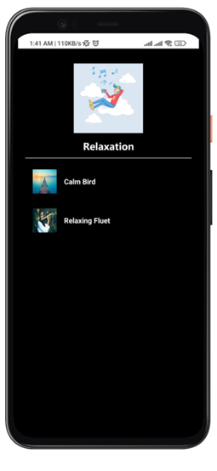
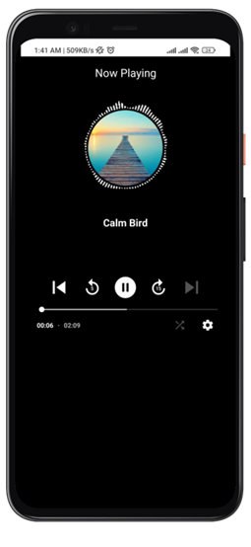
Meditation&Relqxation Screen

Slide 29
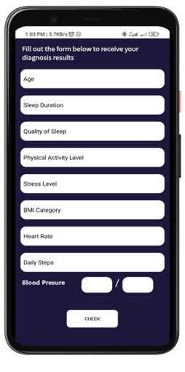
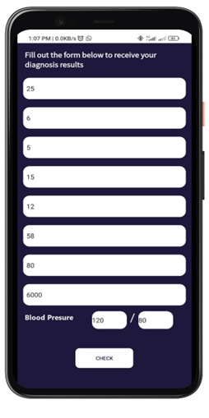
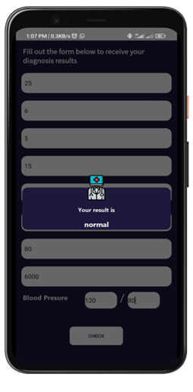
Medical consultant Screen

Slide 30
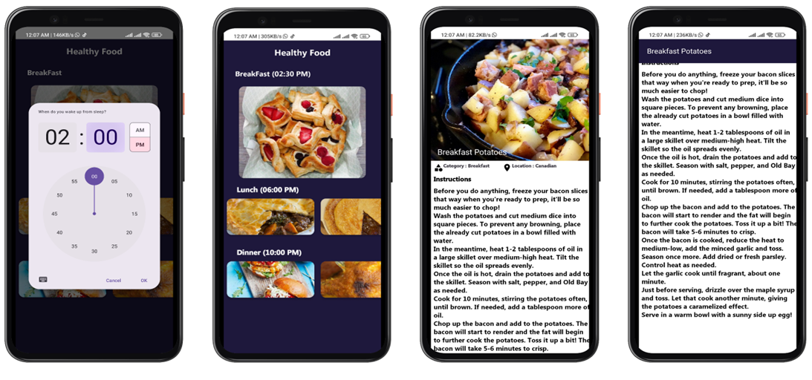
Healthy Foot Screen

Slide 31
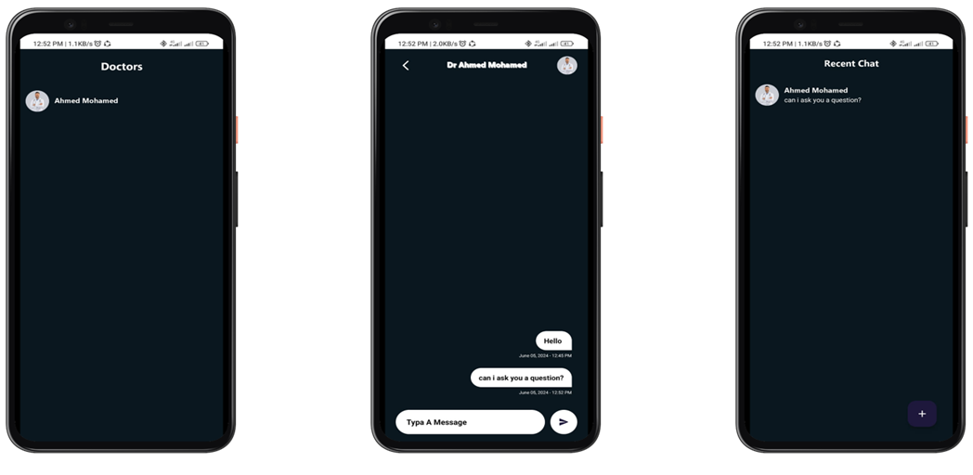
Chat with Doctor Screen

Slide 32
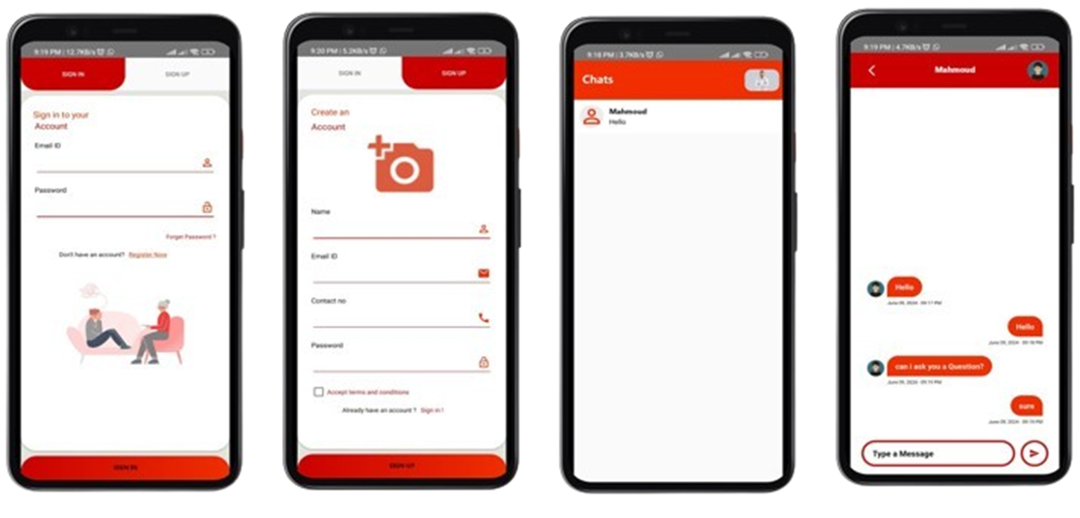
Doctor Chat App Screen

Slide 33
pROPOSED MODEL

Slide 34
Types Of Random Forest
1. Classification Random Forest
2. Regression Random Forest

Slide 35
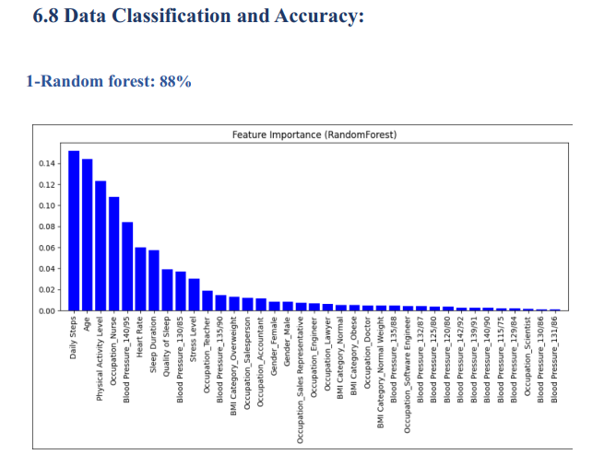

Slide 36
Advantages Of Random forest
1. Highly Accurate.
2. Handles Nonlinearity and Interactions.
3. Implicit Feature Selection.

Slide 37
How Random Forest works
1. Bootstrapped Sampling (Random Sampling with Replacement).
2. Random Feature Selection.
3. Growing Decision Trees.
4. Voting (Classification) or Averaging (Regression).

Slide 38
DATASET

Slide 39
Dataset Overview:
The Sleep Health and Lifestyle Dataset comprises 400 rows and 13 columns, covering a wide range of variables related to sleep and daily habits. It includes details such as gender, age, occupation, sleep duration, quality of sleep, physical activity level, stress levels, BMI category, blood pressure, heart rate, daily steps, and the presence or absence of sleep disorders.

Slide 40
Dataset Columns:
Person ID
Gender
Age
Occupation
Sleep Duration (hours)
Quality of Sleep (scale: 1-10)
Physical Activity Level (minutes/day)
Stress Level (scale: 1-10)
BMI Category
Blood Pressure (systolic/diastolic)
Heart Rate (bpm)
Daily Steps
Sleep Disorder

Slide 41
Details about Sleep Disorder Column:
None: The individual does not exhibit any specific sleep disorder.
Insomnia
Sleep Apnea

Slide 42
Conclusion

Slide 43
This project culminates in the development of an application designed to assist individuals suffering from insomnia by offering a variety of services. Our primary objectives were successfully achieved:
1. *Multifaceted Support*: We have created an application that allows users to initiate discussions with multiple doctors, facilitating access to medical consultations through a novel artificial intelligence experience.
2. *Enhanced Doctor Accessibility*: The app streamlines the process of finding doctors and scheduling appointments, empowering users to book appointments conveniently via text, voice messages, or chat, saving them valuable time.
3. *Improved Communication*: By improving communication channels, patients and doctors can exchange information more efficiently, enhancing overall healthcare interactions.

Slide 44
4. *Diverse Medical Programs*: We introduced various medical programs aimed at fostering lifestyle changes among patients, thereby promoting better health outcomes.
5. *Future Development*: Looking forward, we aim to further enhance and expand the services offered within the application to better meet the needs of our users in the near future.
Throughout this project, we overcame several challenges, including sourcing free content such as books and music for the services provided, and implementing innovative uses of artificial intelligence to improve the user experience and effectively address insomnia-related issues.
In essence, this project represents a successful initiative in providing innovative solutions to insomnia, and we hope it contributes to improving the quality of life for those affected by this condition in the future.

Slide 45
Reference

Slide 46
1. *Books:*
- *"Principles and Practice of Sleep Medicine" by Meir H. Kryger, Thomas Roth, and William C. Dement*: This is a comprehensive textbook that covers various aspects of sleep disorders, including insomnia. It provides in-depth information on the physiology of sleep, diagnosis, and treatment of sleep disorders.
2. *Review Articles and Journals:*
- *"The diagnosis and management of insomnia in clinical practice: a practical evidence-based approach" by Michael Sateia (2014)*: This review article provides a detailed overview of the diagnosis and management strategies for insomnia.
- *"Insomnia: Definitions, Prevalence, Etiology, and Consequences" by Charles M. Morin and Colin A. Espie (2016)*: Published in Sleep Medicine Reviews, this paper offers a thorough examination of the definitions, prevalence, etiology, and consequences of insomnia.
- *"Cognitive behavioral therapy for insomnia (CBT-I)" by Perlis, M.L., et al. (2015)*: This article in the journal Sleep Medicine Clinics provides a detailed overview of CBT-I, one of the most effective treatments for insomnia.

Slide 47
3. *Guidelines and Reports:*
- *American Academy of Sleep Medicine (AASM) Clinical Practice Guidelines for the Pharmacologic Treatment of Chronic Insomnia in Adults*: These guidelines provide evidence-based recommendations for the treatment of chronic insomnia.
- *National Institutes of Health (NIH) State-of-the-Science Conference Statement on Manifestations and Management of Chronic Insomnia in Adults*: This report outlines the findings and recommendations from a conference of experts in the field.
4. *Web Resources:*
- *National Sleep Foundation (NSF)*: Their website offers a wealth of information on sleep health, including articles and resources specifically about insomnia.
- *Sleep Education by the American Academy of Sleep Medicine*: This website provides patient education resources, including detailed information about insomnia and its treatment.

Slide 48
Future Work

Slide 49
1. *Expanding the study sample*:
Future studies could be conducted with a larger, more diverse sample of participants to examine the impact of insomnia across different age groups, cultural backgrounds, and socioeconomic levels.
2. *Developing therapeutic interventions*:
The effectiveness of new types of cognitive behavioral therapy for insomnia (CBT-I) that incorporate new technologies such as virtual reality (VR) therapy or apps for mobile devices can be explored.
3. *Study of biological factors*:
Future research can be conducted to study the relationship between insomnia and some biological indicators, such as genes, hormones, and neural interactions, to gain a deeper understanding of the mechanisms of insomnia and how to treat it.
4. *Technology impact analysis*:
Due to the increased use of electronic devices, the impact of exposure to blue light from screens on sleep quality and insomnia can be studied, and strategies can be developed to reduce its negative impact.

Slide 50
5. *Research into psychological and social factors*:
Studies could be conducted to examine the impact of psychological factors such as anxiety and depression on insomnia, and how to develop comprehensive intervention programs that take these factors into account.
6. *Economic evaluation of treatments*:
The economic costs of insomnia and its impact on productivity and the health system can be explored, and the economic effectiveness of different interventions can be assessed.
7. *Long-term effect of treatments*:
Conduct studies that follow participants over long periods of time to understand the long-term impact of different treatments for insomnia, and ensure that positive results are sustained.
8. *Environment and sleep*:
Explore the effect of the surrounding environment (e.g., noise, temperature, and light) on sleep quality and how to improve environmental conditions to promote good sleep.

Slide 51


THANK YOU

